Slide 1


Alley Explorer
Team member: 陳柏方、洪子茵

Slide 2
Motivation
In some cases, we need to deliver or pass something, such as resources or meals, through the narrow pipe or alley. If the situation allows, we often create some rails to let small cars run. However, it costs lots of extra time or resources to construct those rails. Therefore, we would like to design an auto mobile robot that can autonomously follow the narrow alley or space to deliver resources for us.
Flaws of the current methods: high cost, inflexible
Our methods: low cost, flexible

Slide 3
Method
Front
0°
20°
20°
By dividing surroundings into three parts, front, right and left, and using rpi lidar to detect which one is clear to determine the direction of the robot.
20°
20°
Our robot
20°
20°
90°
270°
Right
Left
180°

Slide 4
Data flow
rate.sleep()
State
++
rate.sleep()
State
++
rate2.sleep()
State
++
rate.sleep()
State 0
State 1
State < 600
State >= 600
stop
Scan
three parts ( front, right, left) using rpi ladar
TURN_FLAG_L
= True
TURN_FLAG_R
= True
TURN_FLAG_L == False
and
TURN_FLAG_R == False
Publish turn left
Publish turn right
rate = rospy.Rate(10)
rate2 = rospy.Rate(350)

Slide 5
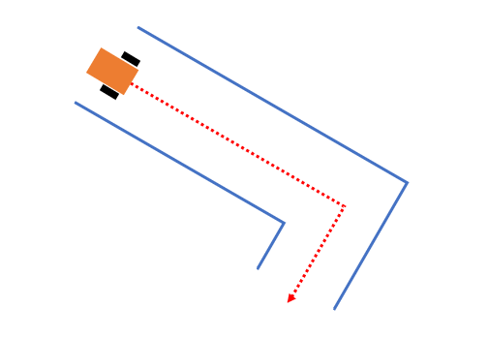
Demo
In the demo, we plan to use huge cardboards to mimic the narrow space that our robot needs to go through. After placing on the one end, our robot will automatically move toward the other end. And it will use rpi lidar sensor to pass it.

Slide 6
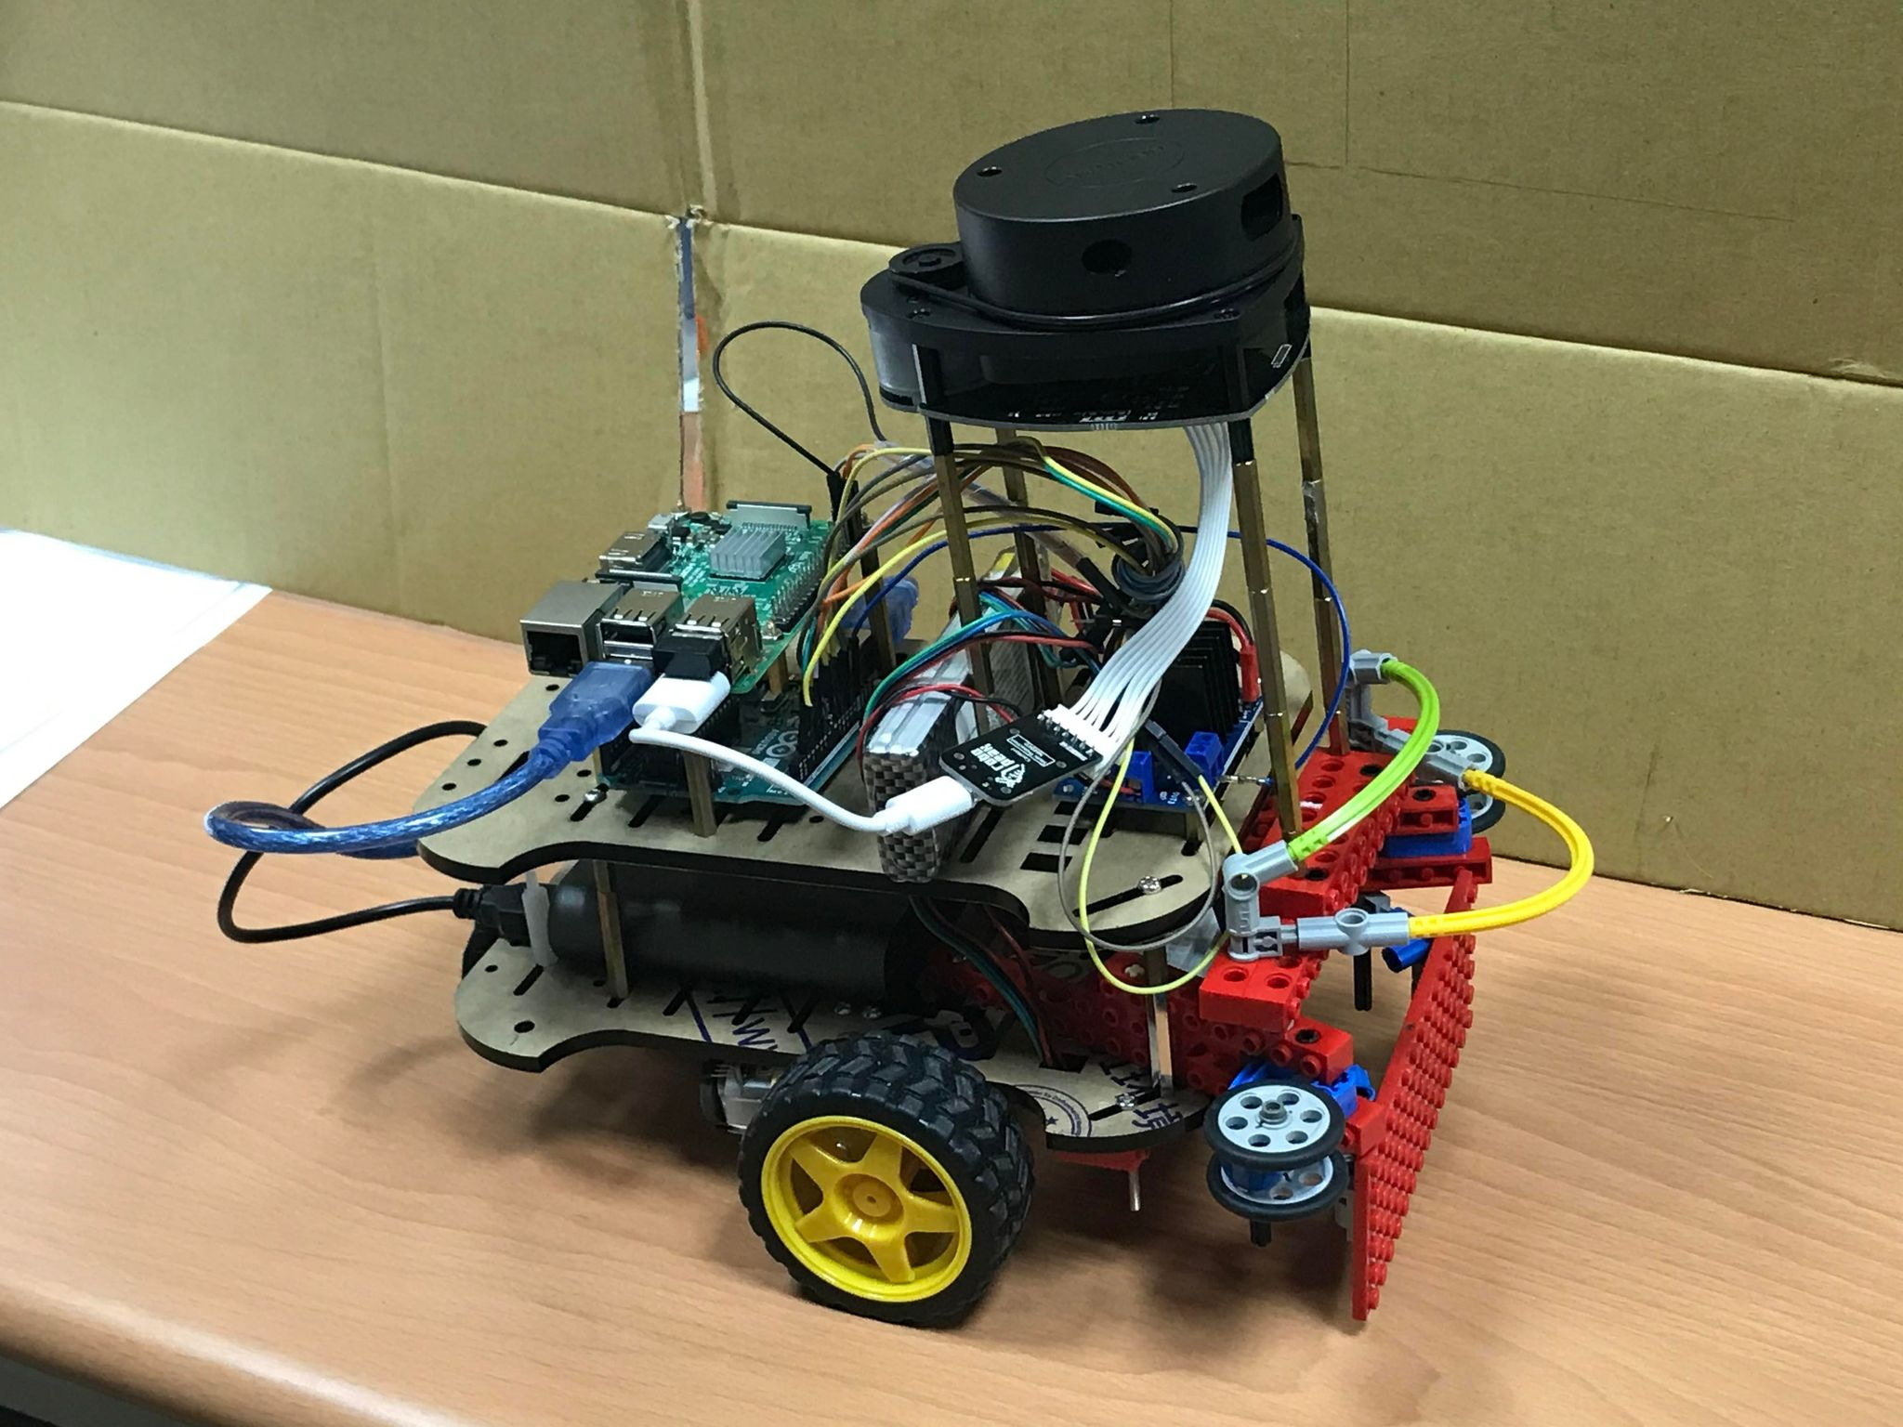
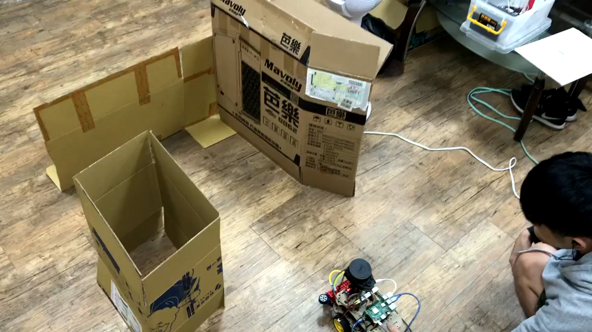
Result
Our robot
Demonstration Video

Slide 7
Future Work
With current algorithm, our robot can only turn for 90°, which means that our robot has only forward, turn right and turn left these three options to choose. If we want to make it has more choice, such as turn right for 45°, we might need to divide the surroundings into more spaces.

